Slide 1

Engineering Design (EEII327 | MCTR 327 | REII327)
Group 10
Group: Power Lifters
Harm Fourie: Lateral Movement
Jonathan Robberts: Hoisting Mechanism
Muhammed Saidoo: Embedded/Main Controller
Erik De Klerk: Wireless pendant
Davin Groenewald: Drive Electronics
Notes:
Creativity is encouraged for the presentation but keep the following in mind:
Professionalism always
Include all group details on the title slide
Although slide limits are not imposed you should complete the presentation in 20min (max)

Slide 2

Main System Requirements
The system must safely support and transport a 35 kg load.
It must provide horizontal movement of the trolley.
It must attach to the load and perform vertical lifting (hoisting) reliably.
The system must offer speed control for both horizontal movement (left/right) and vertical movement (up/down).
An emergency stop mechanism must be available and immediately responsive.
The system must be inherently safe, minimizing risk during operation.
It must include effective and reliable wireless communication between the controller and the system.

Slide 3
Design Aspects
Load capacity (35 kg): Drove the selection of structural dimensions, motor torque ratings, and safety factors to ensure the system can handle the required load under all operating conditions.
Horizontal trolley movement: Led to the development of the lateral movement unit, including the rail design, wheel configuration, and drive mechanism to ensure smooth and controlled travel.
Vertical lifting (hoisting): Determined the motor selection, gearbox ratio, and pulley/hoist mechanism capable of lifting and lowering the load while maintaining stability and control.
Speed control (left/right and up/down): Required the implementation of a motor control strategy (PWM or variable speed drive) and appropriate sensors/feedback loops to achieve precise motion.
Emergency stop: Informed the integration of a dedicated shutdown circuit and fail-safe logic within the control system to ensure immediate stopping capability.
Inherent safety: Influenced design choices such as mechanical limits, overload protection, stable mounting points, and secure attachment of the load.
Wireless communication: Guided the inclusion of a reliable radio module/protocol and proper antenna placement to ensure effective remote operation.

Slide 4
Design concept
Modular system with independent subsystems
Focus on precision, speed control, and safety
Key Components:
Lateral movement (Trolley)
Hoisting mechanism
H-Bridge (Drive Electronics)
Wireless pendant
Main controller

Slide 5
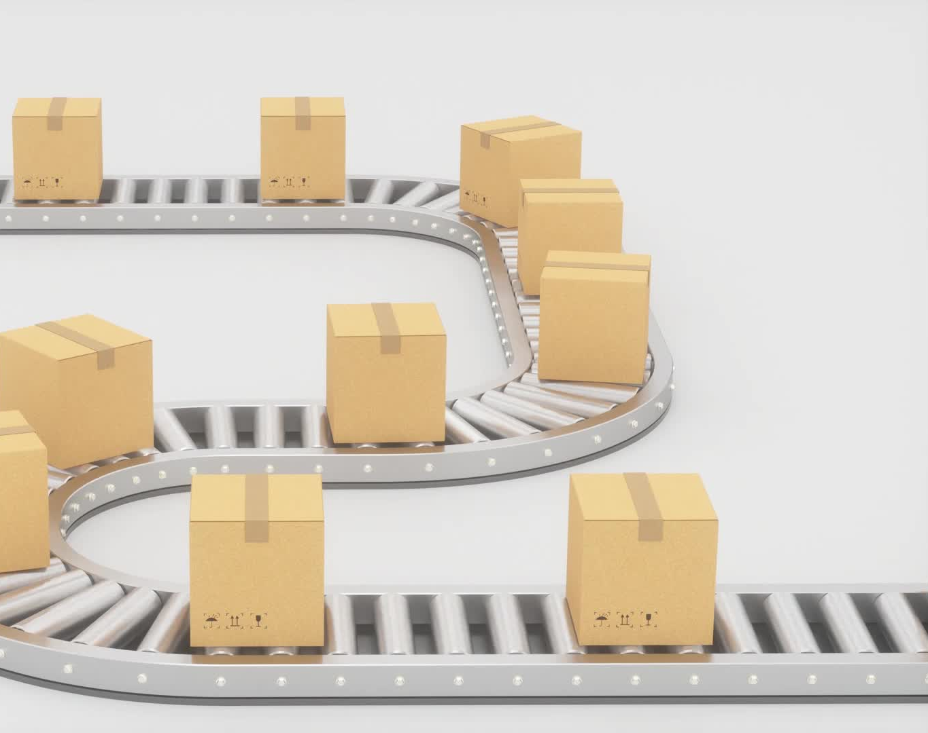
Lateral Movement
Lateral Movement Unit
Provides controlled horizontal motion of the trolley
Driven by motor + gears
Equipped with position sensors for accurate tracking
Independent speed control for smooth operation
Designed to support 35 kg load safely

Slide 6
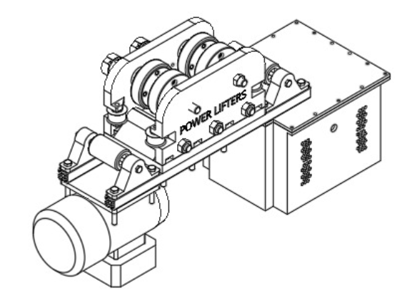
Sketch/CAD for lateral movement

Slide 7
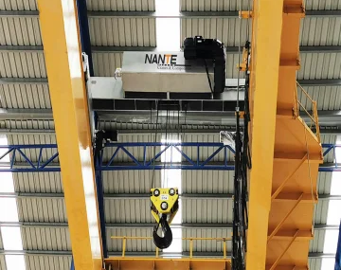
Hoisting Mechanism
Provides lifting and lowering of load
Equipped with sensors to measure length of released cable
Driven by a 3-phase induction motor
Planetary gearbox and worm gear used for high torque conversion and to prevent back drive
Designed to a handle 35kg load

Slide 8
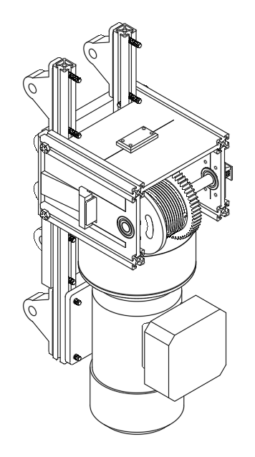
Hoisting mechanism CAD drawing

Slide 9

H-Bridge (Drive-Electronics)
H-Bridge Unit
Provides controlled vertical movement of the spooling system.
Driven by external power supply and PWM from MCU.
Equipped with various components such as MOSFETS and Gate Drivers.
Designed to handle various loads.

Slide 10
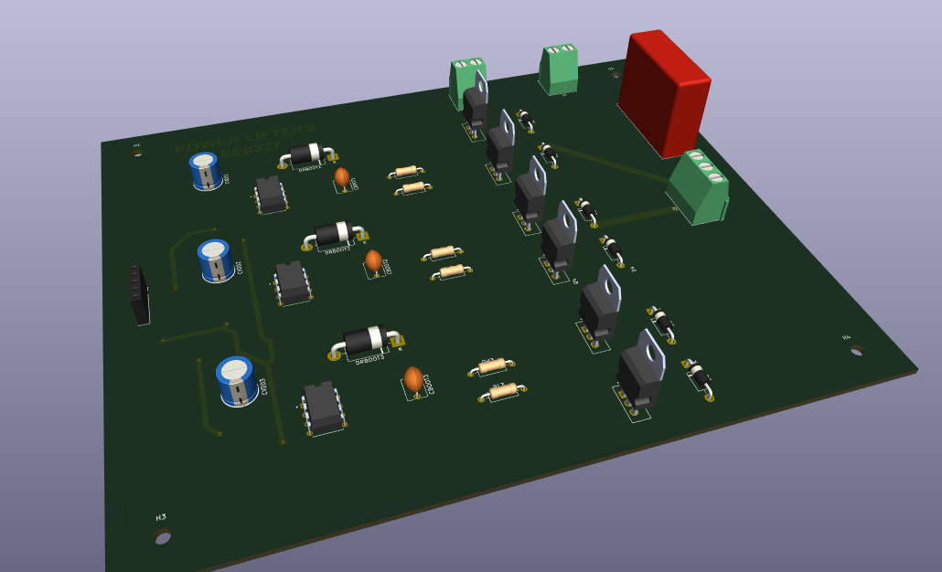
3D CAD View of Final H-Bridge Design

Slide 11
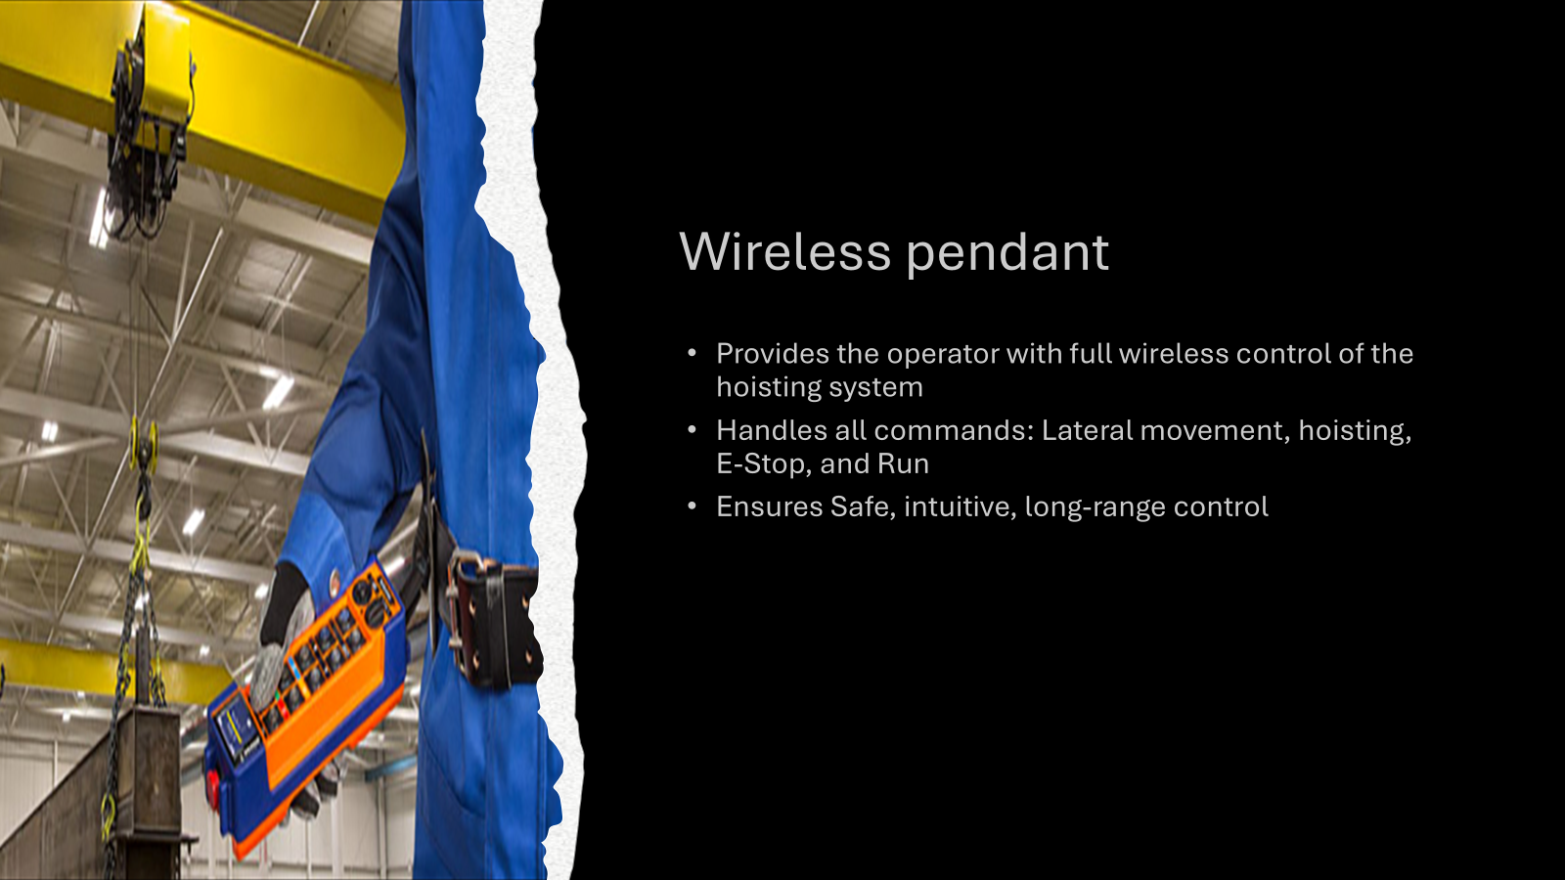

Slide 12
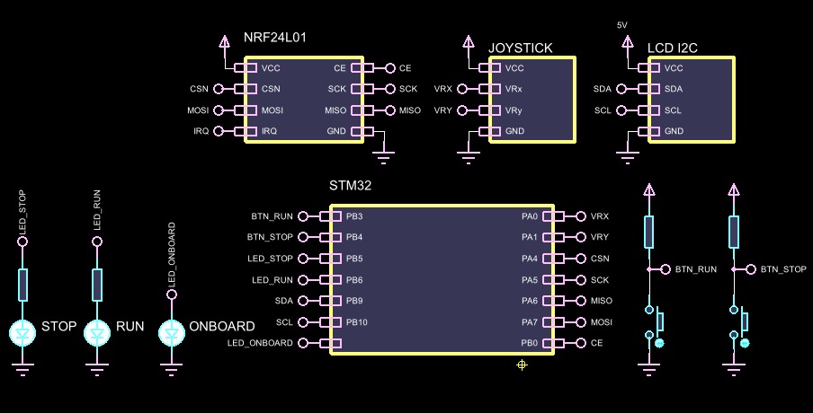
Wireless Pendent Schematic:

Slide 13
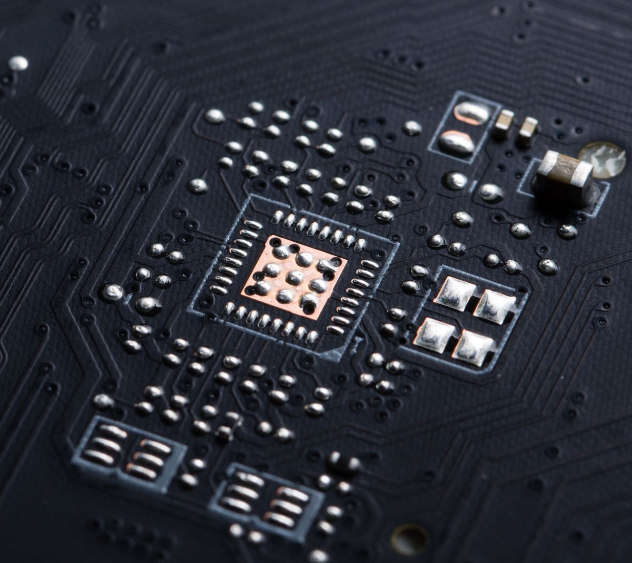
Embedded/Main Controller:
Main Controller which makes use of an STM32 "Blackpill" Microcontroller
Provides controlled vertical lateral movement of the hoisting system by outputting controlled PWM and SPWM signals.
Powered by 5V output from the Power supply unit and produces outputs based on Remote Pendant's transmission packets which are processed by the embedded controller.
Consists of all necessary wiring and connections needed for receiving packets from the remote pendent via an nRF24L01, as well as connections for the drive electronics SPWM signals and the Lateral movement signals.
Designed to work on a 16MHz system clock to reduce power consumption and unnecessary system strain.

Slide 14
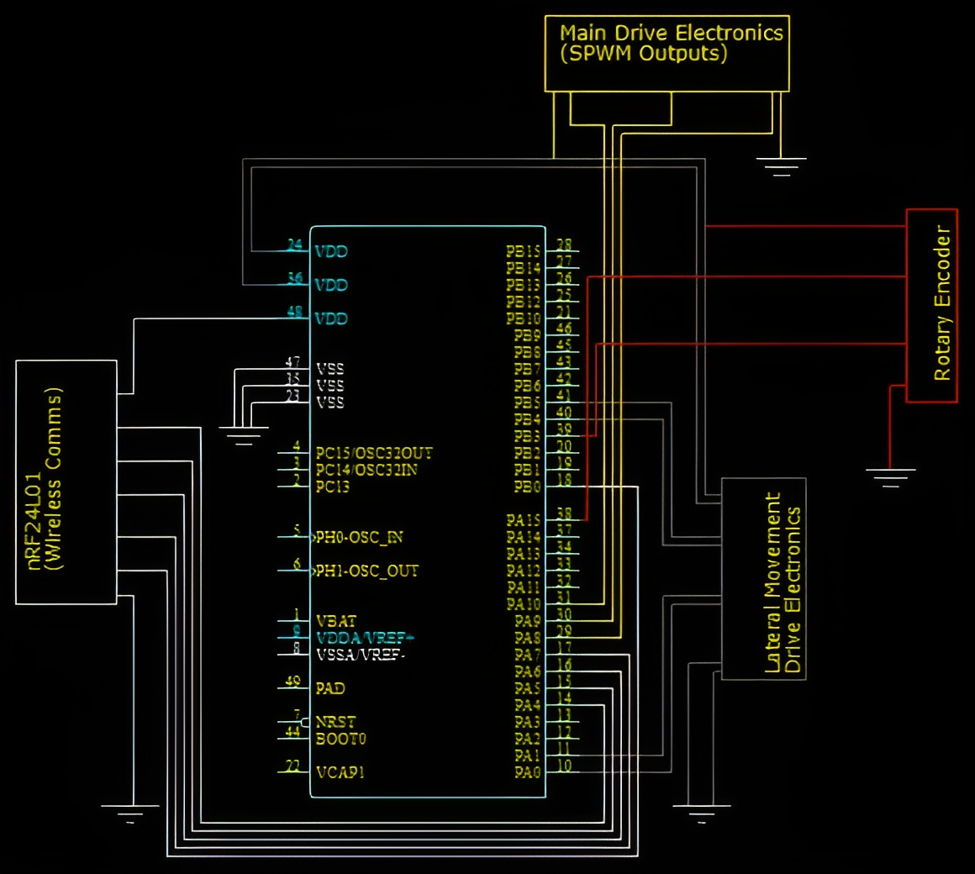
Embedded Controller Schematic:
The on-screen schematic is used to show all the necessary connections that are made to the integrated parts of the system that make use of the embedded controller.

Slide 15
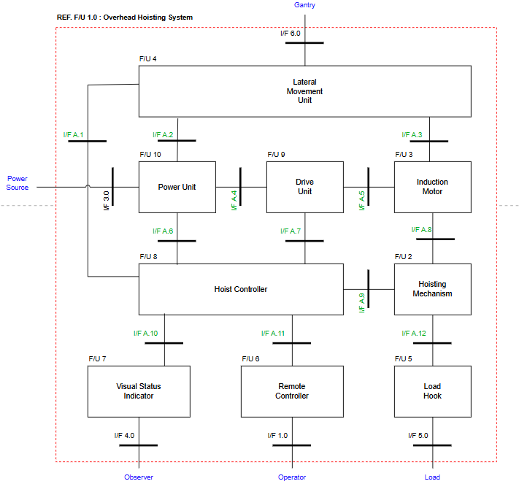
System Architecture

Slide 16
Requirement | Functional unit | Description
Payload Capacity | F/U 4 Lateral movement unit | Carry load of 35kg
Horizontal Speed Requirement | F/U 4 Lateral movement unit | Be able to reach a maximum speed of 0.25 m/s
Travel Path and Range | F/U 4 Lateral movement unit | Trolley shall traverse a U-shaped I-beam track
Contact and Stability | F/U 4 Lateral movement unit | Continuous wheel-to-rail contact
Derailment Prevention | F/U 4 Lateral movement unit | Prevent derailment during start-up, deceleration, or lateral loading events.
Torque Conversion | F/U 2 Hoisting Mechanism | Design gearbox to increase torque provided by motor
Braking mechanism | F/U 2 Hoisting Mechanism | Worm gear to prevent back lock when motor is not turning
Vertical speed requirement | F/U 2 Hoisting Mechanism | Reasonable speed of more than 0.05m/s
Payload capacity | F/U 2 Hoisting Mechanism | Carry a load of 35kg
Control Switching | F/U 9 Drive Electronics | This will allow the switching to take place between the MOSFETS on each phase.
Requirement allocation

Slide 17
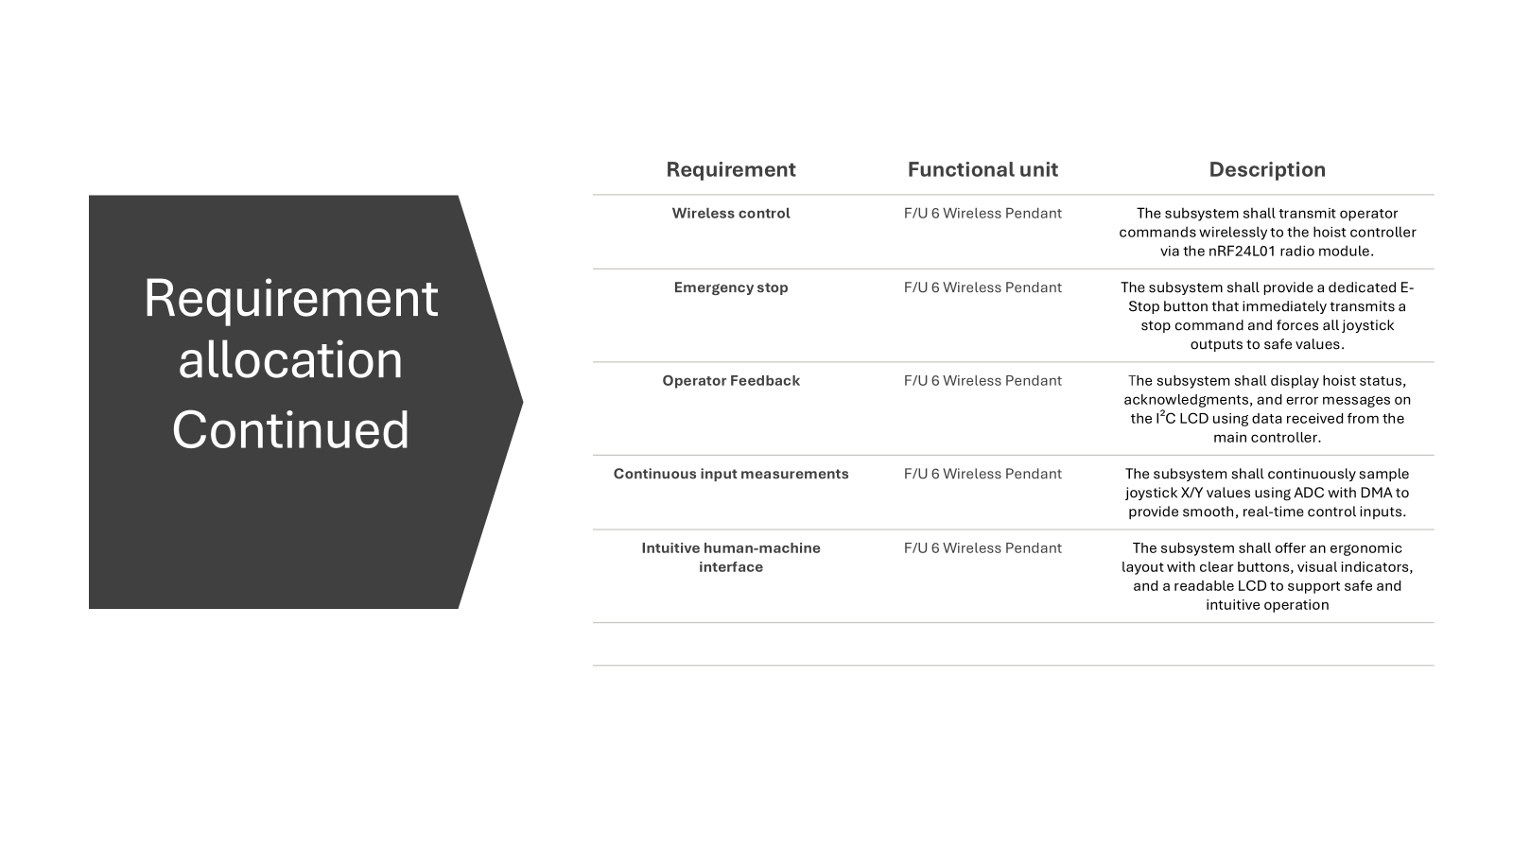

Slide 18

Requirement | Functional unit | Description
Normal 3 phase SPWM for Clockwise motor rotation. | F/U 8 Hoist Controller | Produce sinusoidal PWM signals that are smoothly ramped up from 0 Hz to 50 Hz with an increasing amplitude and vice versa.
120° Phase shifted 3 phase SPWM for Anti-Clockwise motor rotation. | F/U 8 Hoist Controller | Create a 120° Phase shift switching the last 2 phases of the 3 phase SPWM for reversed motor rotation.
Variable SPWM frequencies with accompanying Varying Amplitudes. | F/U 8 Hoist Controller | Produce Varying SPWM’s that have increasing amplitudes as their frequency increases and vice versa.
Lateral Movement using varying PWM. | F/U 8 Hoist Controller | Produce square PWM's that vary their duty cycle at 1000 Hz based on the position of the wireless pendants analogue stick combined with a smooth ramping process to allow for smooth acceleration and deceleration in both directions.
Logging | F/U 8 Hoist Controller | Ensure both the rotary encoder and load cell are functional and working correctly to later display the relevant weight and length of rope extended on the wireless pendants LCD.
RTOS Usage | F/U 8 Hoist Controller | Create a functional embedded controller that makes use of RTOS for effective task prioritisation and processing efficiency.
Emergency Stop | F/U 8 Hoist Controller | Code safety protocols that halt all outputs from the embedded controller safely if communication is lost from the wireless pendant.
Alarm / Safety | F/U 8 Hoist Controller | When the hoist releases more than the threshold values of rope the system should automatically only allow the necessary input to extend or reel in the rope using the forward/reversed SPWM’s. Also either prevent lateral movement or slow It down significantly if too high of a weight is detected by the Load Cell.
Requirement allocation continued

Slide 19
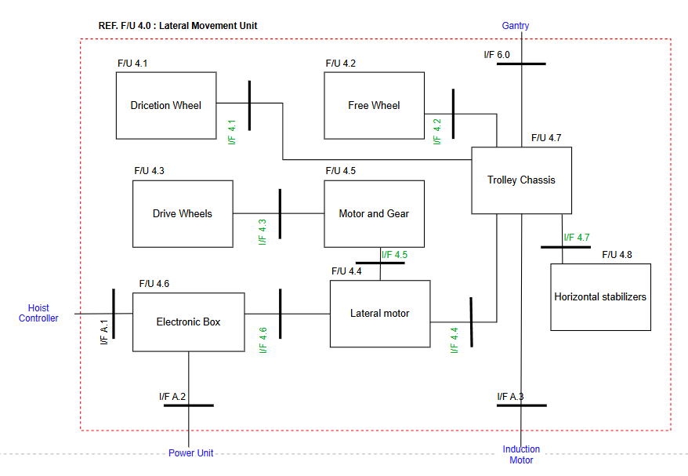
Sub-System: Lateral Movement unit

Slide 20
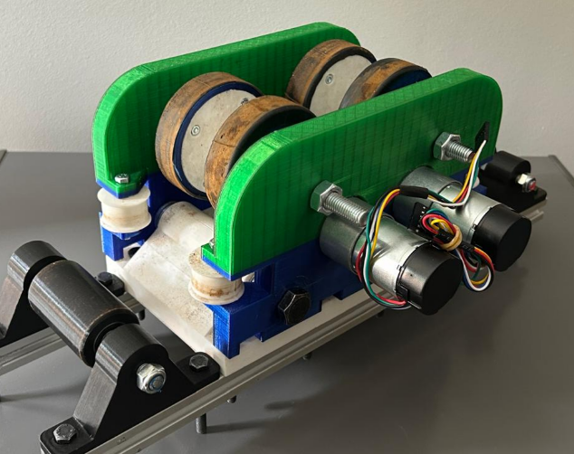
The lateral movement subsystem uses two geared DC motors with rubber-coated wheels and a dual 12 A driver to move the hoist horizontally along the 4-meter diameter curved I-beam. Speed and direction are controlled via PWM signals from the main controller

Slide 21
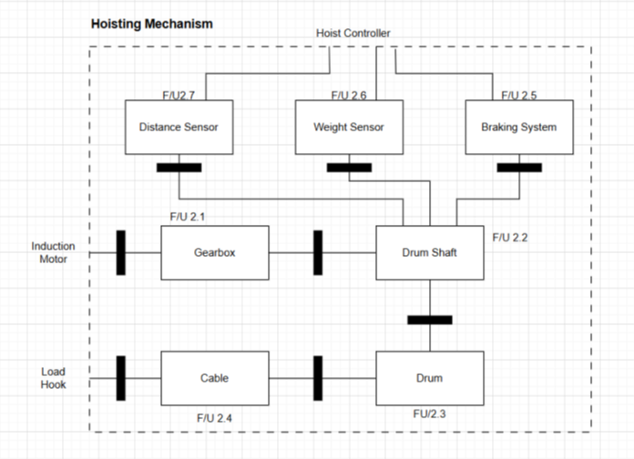
Sub system: Hoisting Mechanism Unit

Slide 22
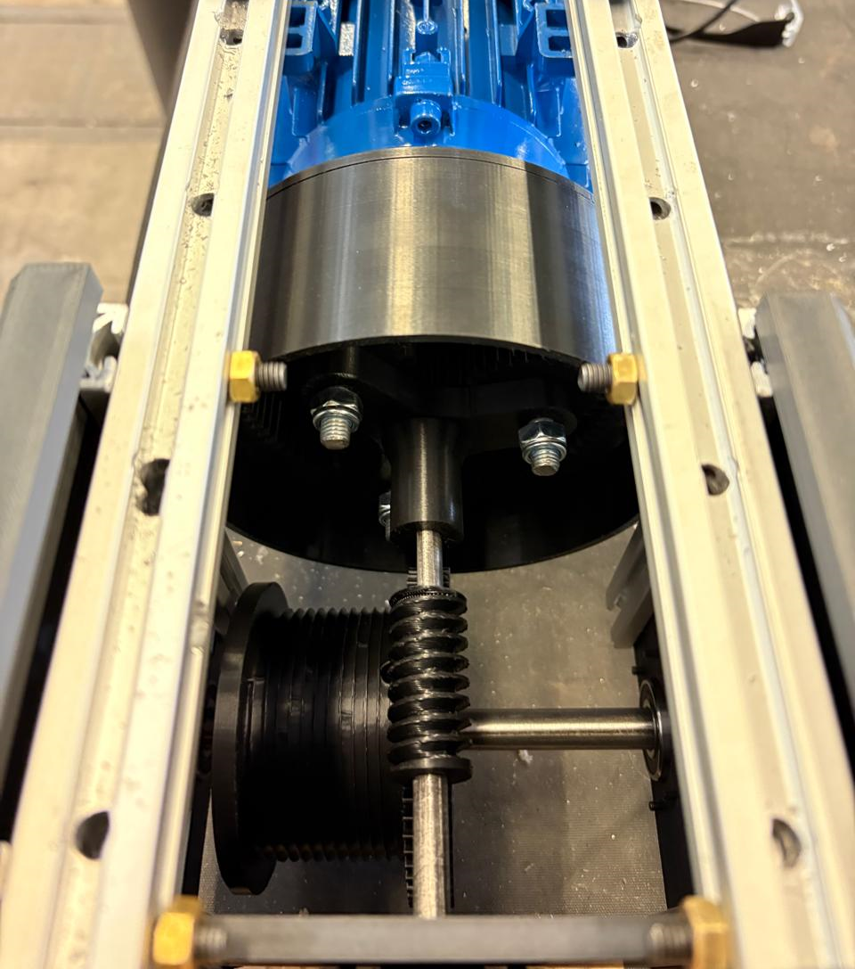
The Hoisting mechanism uses a planetary gearbox with the input connected to the induction motor and the output connected to a worm gear. The worm gear which drives the drum and prevents back lock when motor is not turning.

Slide 23
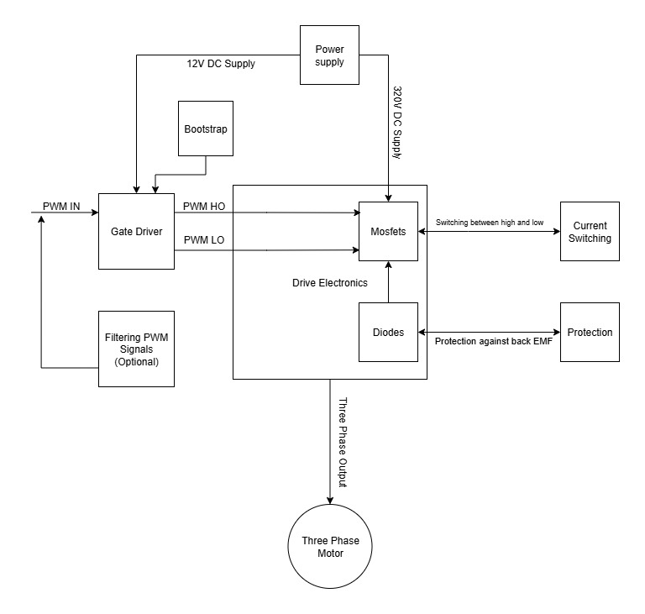
Sub-System: Drive Electronics

Slide 24
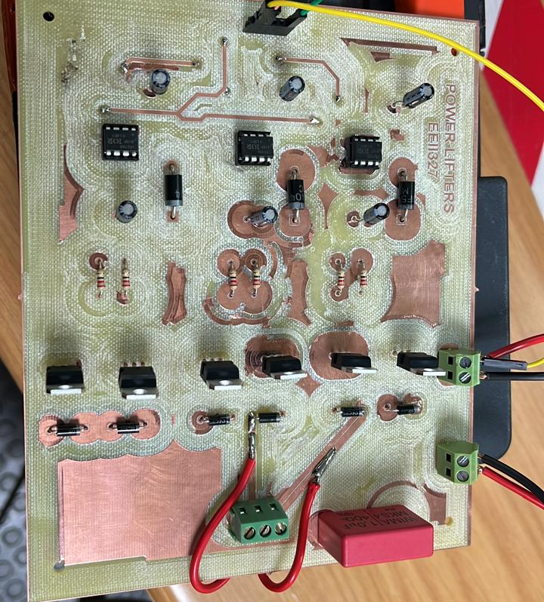
The drive-electronics subsystem uses a three-phase MOSFET inverter powered from a 320 V DC bus, with each phase driven through IR2104 high- and low-side gate-driver stages. All control signals from the main controller pass through an optocoupler isolation circuit, and sinusoidal PWM is used to regulate motor speed and direction with precise phase control.

Slide 25
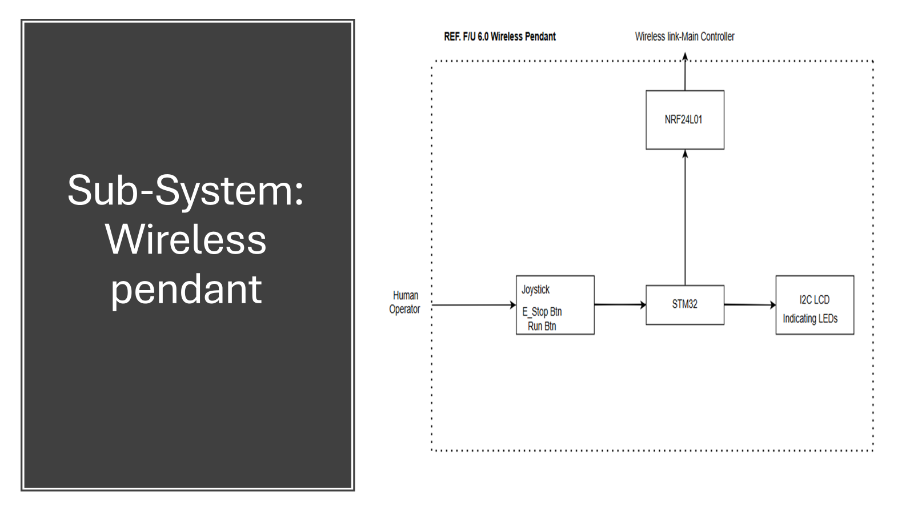
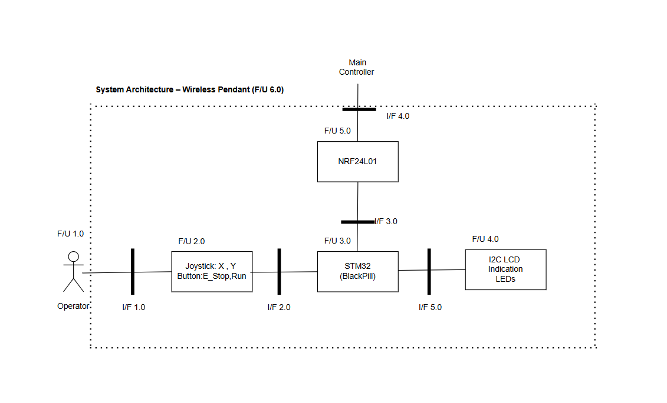

Slide 26
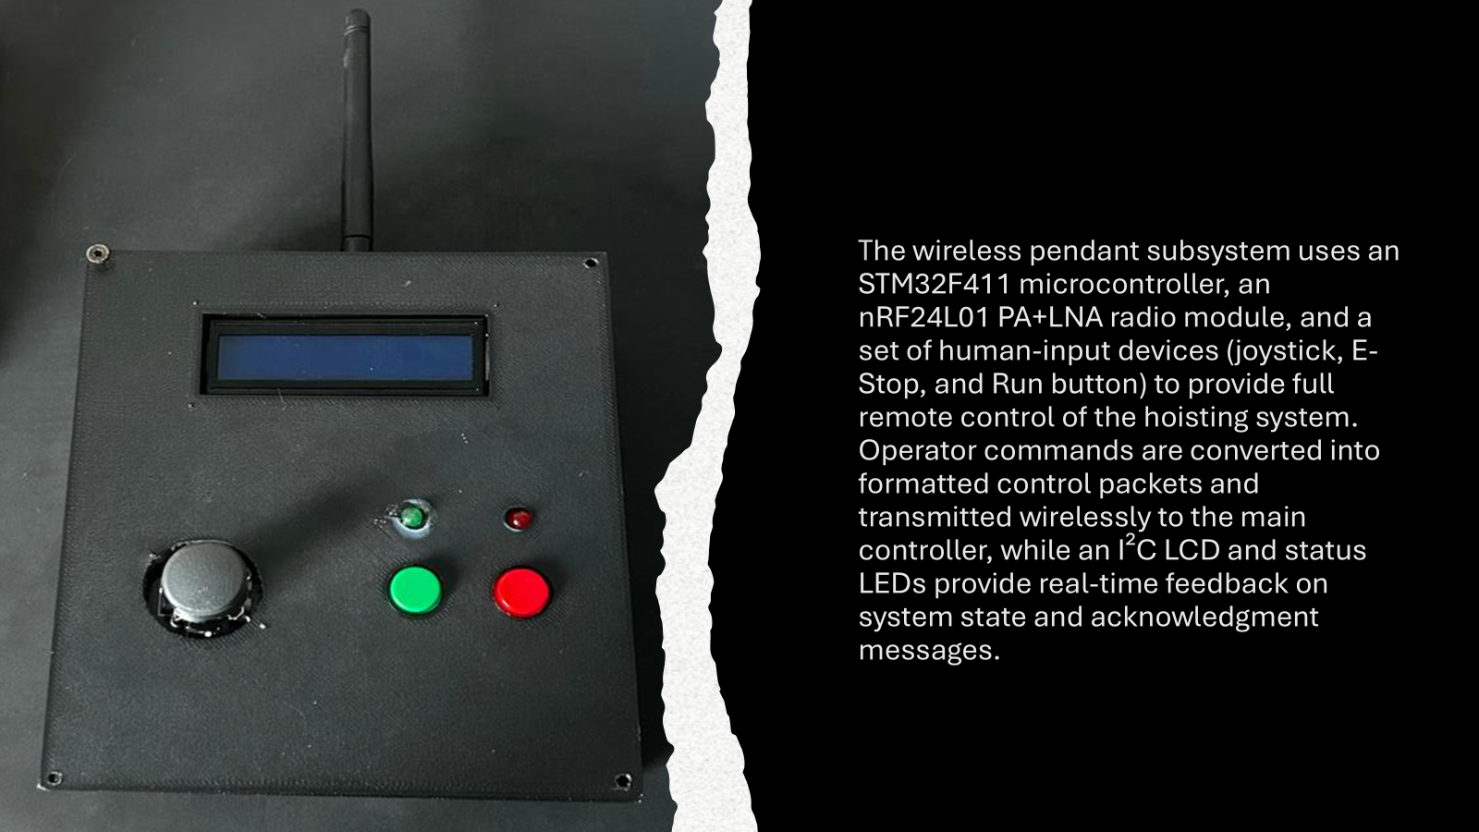

Slide 27
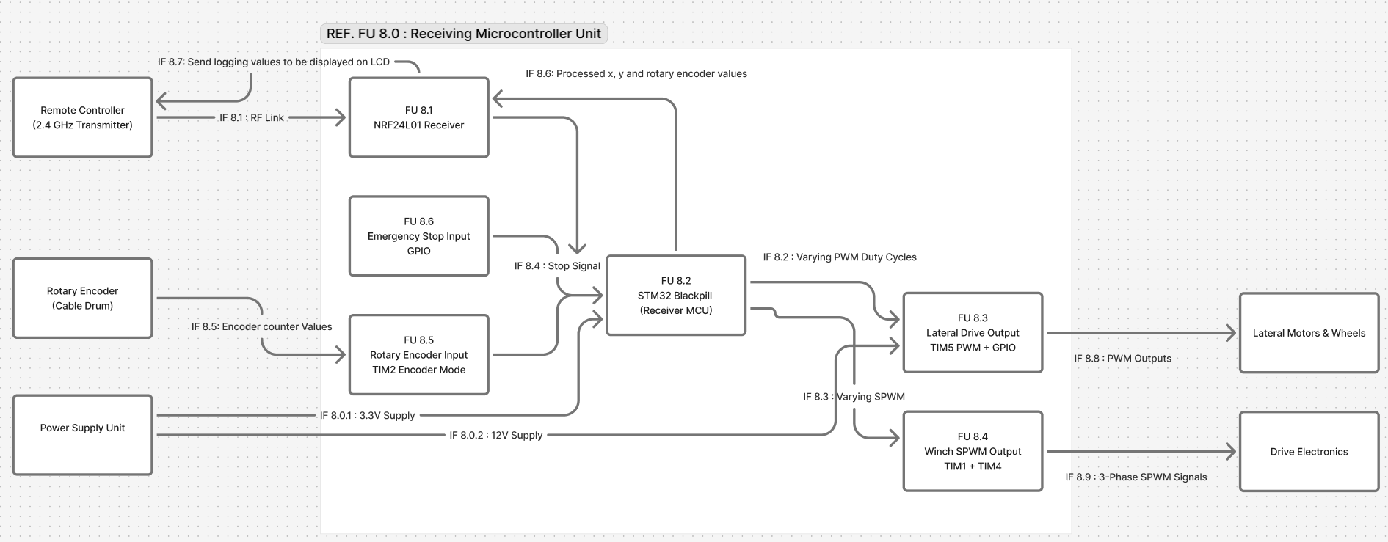
Sub-System: Embedded Controller

Slide 28
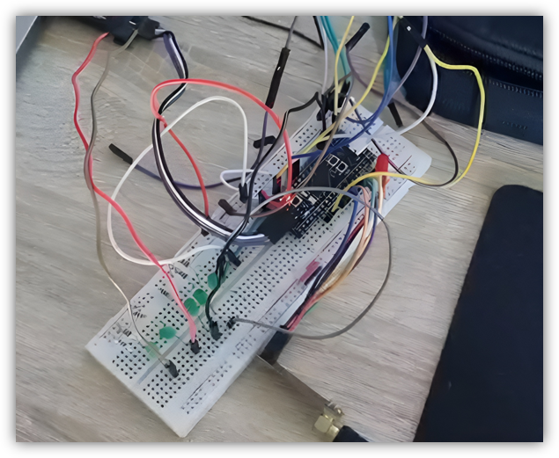
The embedded controller applies smooth ramping to both the lateral and hoist motions so the trolley never “snaps” into movement. First, the wireless pendent joystick's X and Y-input is translated into a target speed for lateral movement and hoist speed, but a ramp algorithm only allows the actual speed command to change in small steps every few milliseconds, giving a gentle start, stop, and change of direction, producing controlled acceleration and deceleration based on the position of the joystick. If communication with the wireless pendent is lost, both ramp controllers gradually drive their speed commands back down to zero, bringing the system to a smooth, controlled stop rather than a sudden cut-off which may cause damage to the drive electronics and lateral movement components.
If the rotary encoder shows that the cable is outside the 0.1–2 m threshold, the system will only allows for certain SPWM directions, for example, if the rope is at 2m then the system prevents the forward SPWM output and only allows the use of the Reverse SPWM's to prevent over-extending the rope or pulling the hoisted object too close.
The Embedded controller is also connected to a load cell for load weight monitoring. This alongside the rotary encoder allows the embedded controller to log the length of rope as well as the weight hoisted by the system and deal with extreme cases using safety protocols that are coded into the STM32 "Blackpill."

Slide 29
System Performance

Slide 30
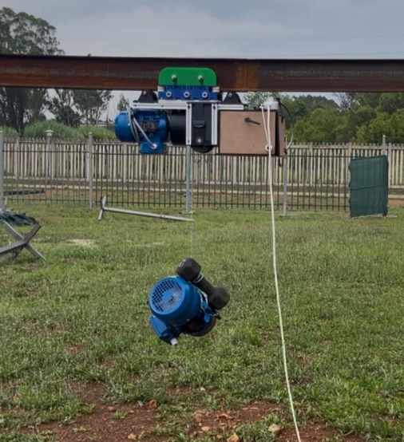
Lateral movement
The video link (https://youtu.be/gM-aiSlf644 ) demonstrates the run.

Slide 31
Report Performance for Lateral unit
Requirement No. | Description | Verification Method | Result
1 | Lateral Motion Functionality | Laboratory integration test and full-track testing | Met — smooth forward/reverse motion observed
2 | Payload Capacity (50 kg total) | Testing with 20 kg (available test load) + structural assessment | Met — no stalling, overheating, or instability
3 | Speed Requirement (0.25 m/s under load) | Speed testing with video analysis | Met — measured loaded speed: 0.24 m/s
4 | Travel Path and Range (4.0 m U-shape) | Full-track traversal video test | Met — trolley completed full path
5 | Contact and Stability | Visual inspection during movement | Met — all wheels maintained contact; no tilt observed
6 | Derailment Prevention | Track testing with start/stop and cornering | Met — no derailment or wheel lifting
7 | Control and Safety Integration | Wireless pendant + controller integration test | Met — smooth control, stable PWM behaviour

Slide 32
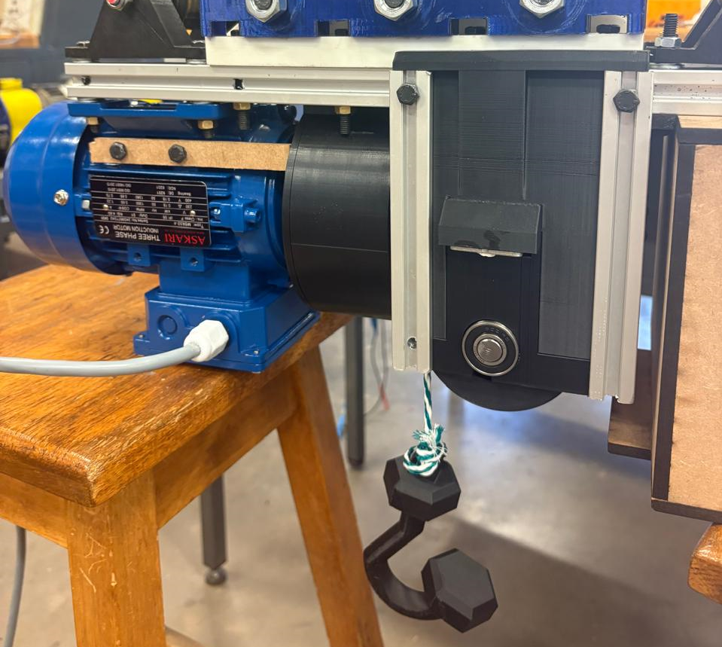
Hoisting Mechanism
Video link for lifting test (https://youtube.com/shorts/1gToyO-XPMc)

Slide 33
Report Performance for Hoisting Mechanism
Requirement No. | Description | Verification Method | Result
1 | Vertical Motion Functionality | Laboratory test and Integration test | Met — smooth upward/downward motion observed
2 | Payload Capacity (35 kg total) | Testing with 20 kg (available test load) + structural assessment | Met — payload was raised easily without slipping
3 | Speed Requirement (0.05 m/s under load) | Speed testing with video analysis | Met — measured loaded speed: 0.06 m/s
4 | Torque Conversion | Operate system with a load | Met — output speed was reduced and output torque increased
5 | Breaking mechanism | Add load to system while motor in idle | Met — no slipping of worm gear and load stayed stationary

Slide 34
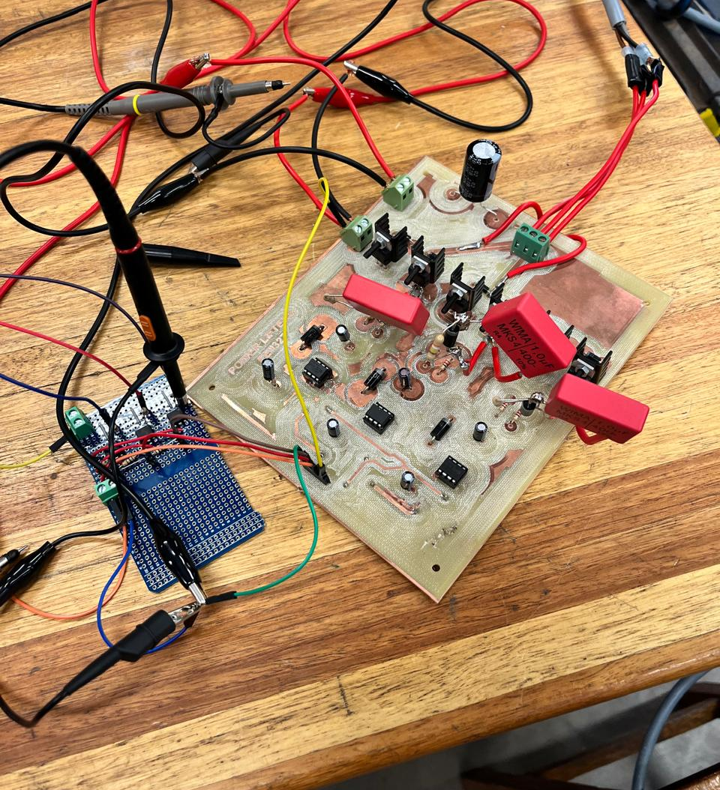
Drive Electronics(H-Bridge)
The video link (Video 4.mp4 ) demonstrates that the H-bridge functions well on low voltage. It was able to rotate the motor both clockwise and anti-clockwise with the help of the MCU and the Vertical Movement Teammates. I had to add snubber circuits to reduce ringing in the circuit.

Slide 35
Report Performance for H-Bridge
(System Failure)
Requirement No. | Description | Verification Method | Result
1 | Clockwise Rotation | Laboratory test while Integrated with MCU | Met — smooth clockwise rotation on low voltage application.
2 | Anti-clockwise Rotation | Testing with microcontroller PWM signals | Met — smooth anti-clockwise rotation on low voltage application.
3 | Speed Requirement | The speed was only verified on low voltage. When voltage was increased the PCB and components broke. | Met/ Not Met — Low speed on low voltage met, but high speed on high voltage application not met.

Slide 36
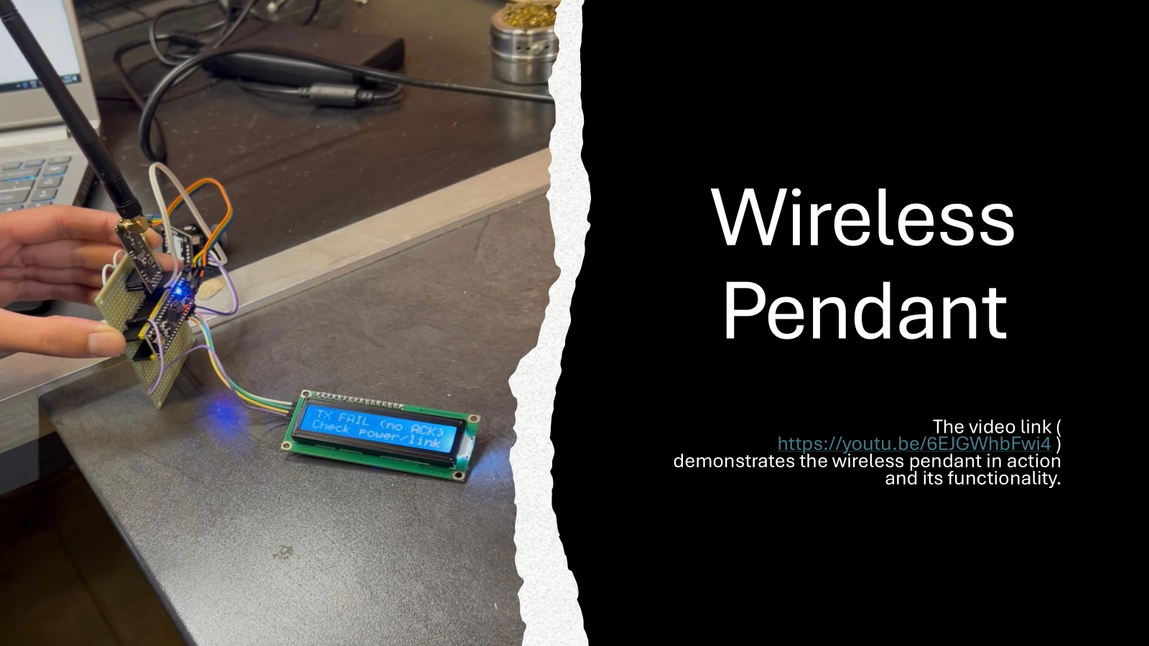

Slide 37
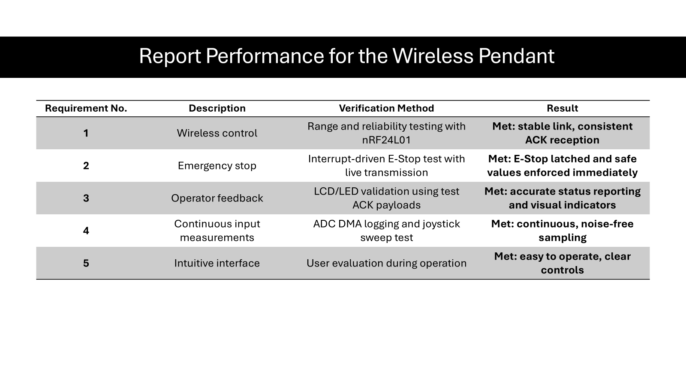

Slide 38
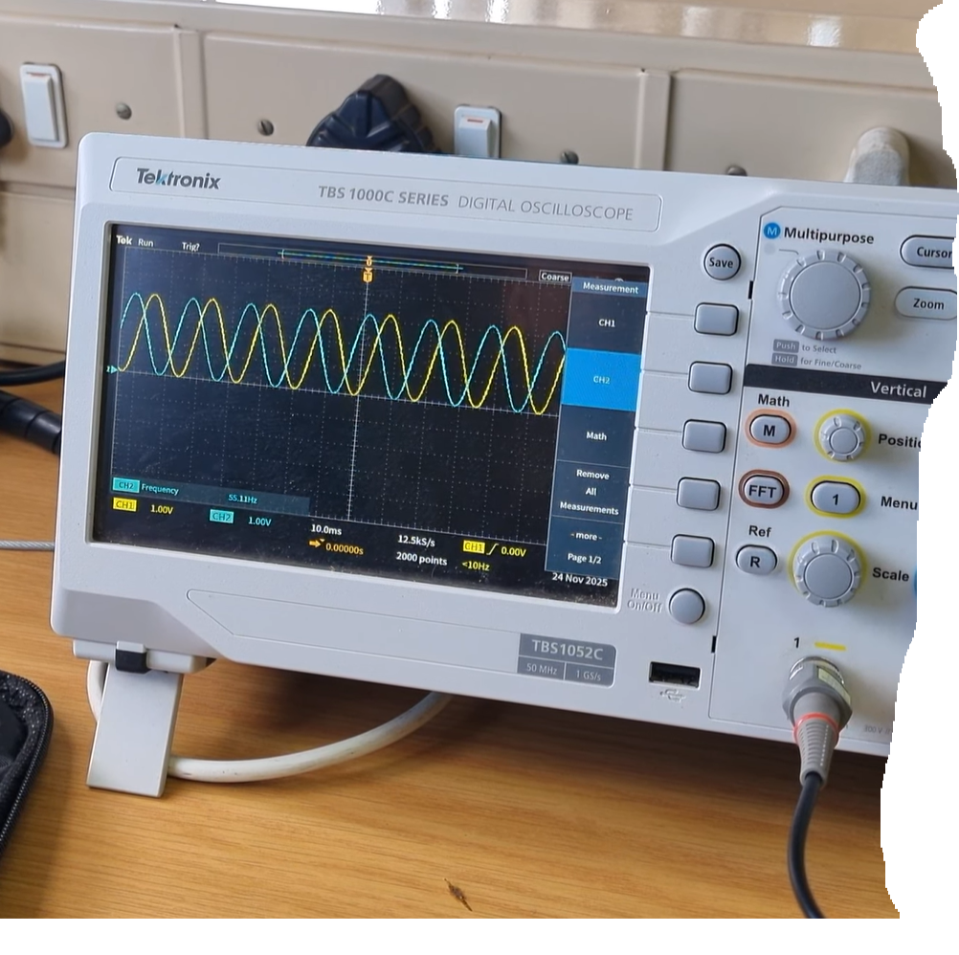
Embedded Controller
https://youtu.be/o6YtptXUakM?si=Tz7EXiTFnEbT5l4_
The above video link shows the integration of the embedded controller and wireless pendent with regards to the Forward and Reversed SPWM signals that are to be sent to the drive electronics. The video demonstrates the varying amplitudes and frequencies as well as an explanation for the slower reversed frequency. Videos regarding the lateral movement and wireless integration can be seen on the previous slides. The links below shows a video regarding the forward and reversed SPWM's with no wireless integration, the load cell working and the working rotary encoder.
https://youtu.be/B9fsbKZ2n8I?si=ttUy9z3HcEQHzto8
https://youtube.com/shorts/GiuNbUcU1tI?si=g98gQNOW_XRaXSY4
https://youtube.com/shorts/8iOUVHw6SN4?si=gh9_9giAJZZgFc2U
(Putting closed captions on is suggested)

Slide 39
Requirement No. | Description | Verification Method | Result
1 | Normal 3 phase SPWM for Clockwise motor rotation. | Laboratory test using a capacitive low pass filter and oscilloscope. | Met — Sinusoidal PWM signals were visually monitored and smoothly ramped up from (essentially) 0 Hz to 55 Hz with an increasing amplitude and vice versa.
2 | 120° Phase shifted 3 phase SPWM for Anti-Clockwise motor rotation. | Laboratory test using a capacitive low pass filter and oscilloscope. | Met — Same result as for 1 but with a clearly observed 120° Phase shift switching the last 2 phases for reversed motor rotation.
3 | Variable SPWM frequencies with accompanying Varying Amplitudes. | Laboratory test using a capacitive low pass filter and oscilloscope. | Met — Observed the varying SPWM frequencies and accompanying amplitudes via an oscilloscope.
Report Performance for Embedded Controller

Slide 40
Requirement No. | Description | Verification Method | Result
4 | Lateral Movement using varying PWM. | Laboratory test using a capacitive low pass filter and oscilloscope. Use of indication LED's and tested via integration with lateral movement. | Met – Square PWM's that varied their duty cycle based on the position of the analogue stick combined with a smooth ramping process allowed for smooth acceleration and deceleration in both directions.
5 | Logging | Made use of the STM32CubeIDE to view details regarding the load cell and rotary encoder output. Later translated to Wireless Pendent LCD. | Met – Both the rotary encoder and load cell are functional and working correctly displaying the relevant weight and length of rope extended. Not Met – Load cell was damaged and so we were unable to fully integrate it but the software for it is still functional.
Report Performance for Embedded Controller (Continued)

Slide 41
Requirement No. | Description | Verification Method | Result
6 | RTOS Usage | Checking the code flashed on the STM32 microcontroller. | Not Met – Unable to create a functional controller that made use of RTOS.
7 | Emergency Stop | Tested via usage in integration. | Met – Coded Safety protocols that would ramp down and halt all outputs from the embedded controller if communication was lost from the wireless controller. Made the module completely dependent on the wireless pendent.
8 | Alarm / Safety | Unable to fully verify due to load cell being unavailable. Tested via integration testing. | Met – When the hoist releases <0.1m or >2m of rope the system automatically only allows the necessary input to extend or reel in the rope using the forward/ reversed SPWM’s. Not Met – Load Cell could not be implemented.
Report Performance for Embedded Controller (Continued)

Slide 42
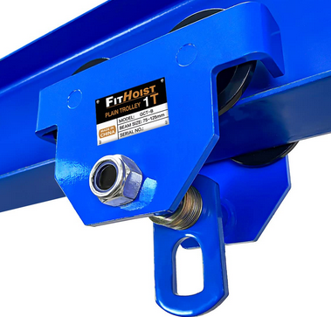
Manoeuvrability
Full simultaneous operation: raise/lower + move forward/reverse at the same time.
Smoothly follows 4 m U-shaped track including tight curves
Load does not swing – stabilizers keep trolley perfectly level (verified in all videos)
Mechanical guide wheels make derailment impossible
Result: Highly maneuverable, stable, and safe – behaves like a professional system.

Slide 43
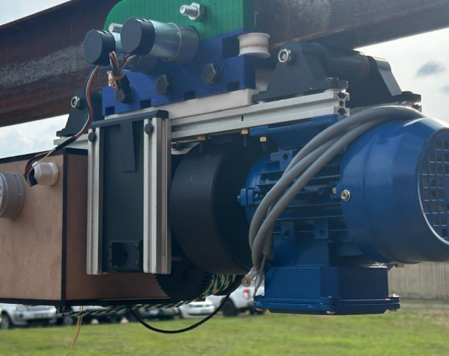
Integration by parts
Lateral movement unit -> Hoisting mechanism
Lateral movement unit -> Wireless pendant
Lateral movement unit -> Main controller
Lateral movement unit -> Spec Power supply
Video link https://youtu.be/gM-aiSlf644

Slide 44
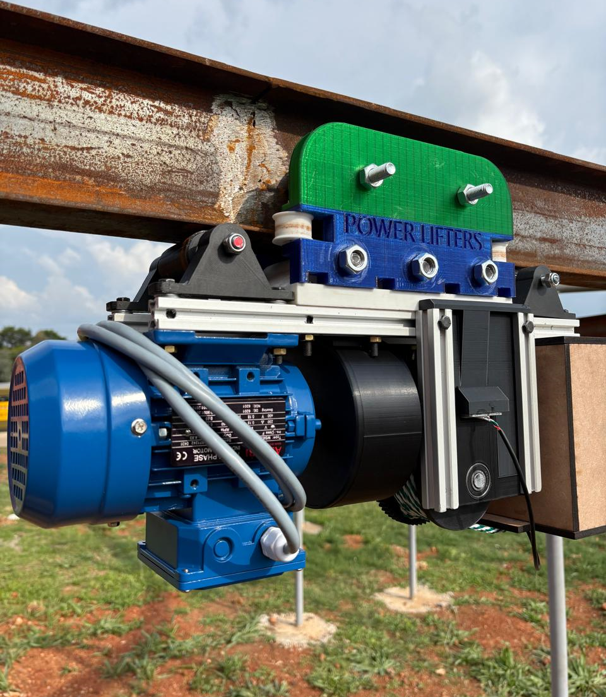
Integration by Parts
Hoisting mechanism -> Lateral Movement
Hoisting mechanism -> Driver electronics
Hoisting mechanism -> Wireless pendant
Hoisting mechanism -> Main controller
Video link for integration:
(https://youtube.com/shorts/v_BzBenlAYk)

Slide 45
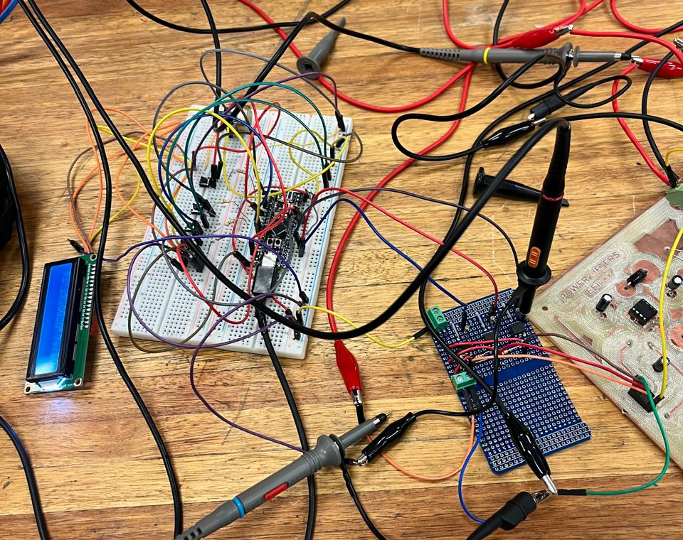
Integration by parts
Drive Electronics-> Hoisting mechanism
Drive Electronics-> Main Controller PWM
Video link Video 2.mp4

Slide 46

Overall performance
Wireless pendant: works perfectly
Main controller: works perfectly
Lateral movement: works perfectly
Hoisting mechanism (mechanical): works perfectly
Induction motor driver: does NOT work properly (only ~150 V instead of 320 V → very weak lifting)
Everything we built works great except the induction motor driver. Because of that single faulty subsystem, the overall hoist performance is average.

Slide 47

Conclusion
This design project provided a valuable learning experience, especially for students beginning to engage with real engineering design processes. It offered practical insight into how design work is carried out, and highlighted the important considerations that must be addressed before entering the professional environment where the consequences are real. Overall, the project was successful and contributed significantly to our understanding. The experience gained has strengthened our confidence and better prepared us for next year’s final-year project.

Slide 48
Design Improvements
Lateral movement
->Better wheel coat for the wheels
->Better electronic box design ,,more space for everything
->Laser cutting instead of 3d printing for strength
Hoisting mechanism
->better material for gears to prevent wear
->better lubrication of planetary gearbox to reduce noise
Drive Electronics
->Choose a better switching component with less ringing in circuit
->Design a better layout for the PCB for less inductive ringing in circuit.
-> Rather than making a PCB on campus, I would send it in to a place like JLCPCB to be manufactured more accurately.
-> Order components much earlier so that we can perform tests much earlier, especially if we are working on a strict deadline.
Wireless pendant
->Make use of two joysticks, one for lateral movement and one for vertical movement
->Design a custom PCB instead of using a prototype PCB
->Using a simple moving-average filter or EMA would smooth the joystick response.
->Could improve enclosure design
->Add battery level monitoring
Embedded Controller
-> Use of a designed PCB instead of a breadboard for neater, more stable and professional looking connections.
-> Make use of a 3.3V regulator to limit noise and increase output stability. -> Add extra Status LED's onto the embedded controller itself. -> Create a custom mount for the Embedded controller within the on-board enclosure for better space usage.
-> Code slower ramp times and make use of a less sensitive analogue stick for easier and more stable control.

Slide 49
Design process
The design process is important for customer requirements to reach it and the design is also important to minimize risk
A structured design process also promotes efficient-decision making, helping the team justify design choices and maintain throughout development
Our group was unable to fully integrate the system due because the driver unit could not operate at the required 330V Ac
Integration can take longer than expected

Slide 50
Group Dynamics
We learned the importance of earlier subsystem integration and setting aside time (time management) for debugging and validation in future projects.
The division of responsibilities worked well, and teamwork strengthened during integration, with everyone helping across mechanical, electrical, and software tasks.
The drive electronics caused delays in project finalization near the end of the deadline. The drive electronics also had a system failure do to faulty connections.

Slide 51
Closing Statement
This project gave us valuable hands-on experience in mechanical design, embedded systems, motor control, power electronics, and system integration.
Each subsystem functioned successfully, and full system performance was strong despite the inverter voltage limitation.
We gained a realistic understanding of the engineering design process, from concept to implementation and testing.
The lessons learned will greatly strengthen our technical ability and teamwork for future engineering projects.
Thank you for your time. We welcome any questions.

